Slide 1


Slide 2



Sponsored By

Slide 3





Slide 4


Slide 5

Governor Kim Reynolds:
Making Iowa An Employment Destination
“Over the last four years, we’ve built a strong foundation upon which Iowa can continue to rise…A place where families thrive, businesses grow, and government is responsive to the people.”
- Remarks at 2023 Inauguration

Slide 6





State of the Workforce – August 2023
Unemployment Rate
2.9 percent (Tied for 20th)
Labor Force Participation
68.7 percent (Tied for 4th)
Total Employed Iowans
1,588,000 (+6,100 above March 2020)
Median Household Income
6.3% (two-year growth rate)
Wage Growth
+9.4% (Average Annual Wage)

Slide 7
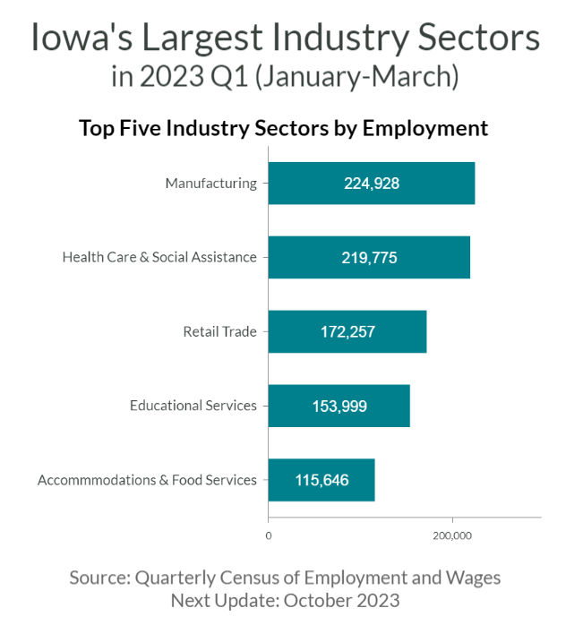
Ready to Work with Specialized Skills
+5 points higher
Iowa stands well above national labor force participation (68.7 precent to 62.8 percent)
#3 in U.S.
Third highest concentration of manufacturing industry employment in the U.S. based on location quotient (used to measure industrial specialization compared to the country as a whole)
+23,900
Strong labor force growth in recent months, with more Iowans in the labor force today than prior to pandemic
Notes:
May Numbers

Slide 8
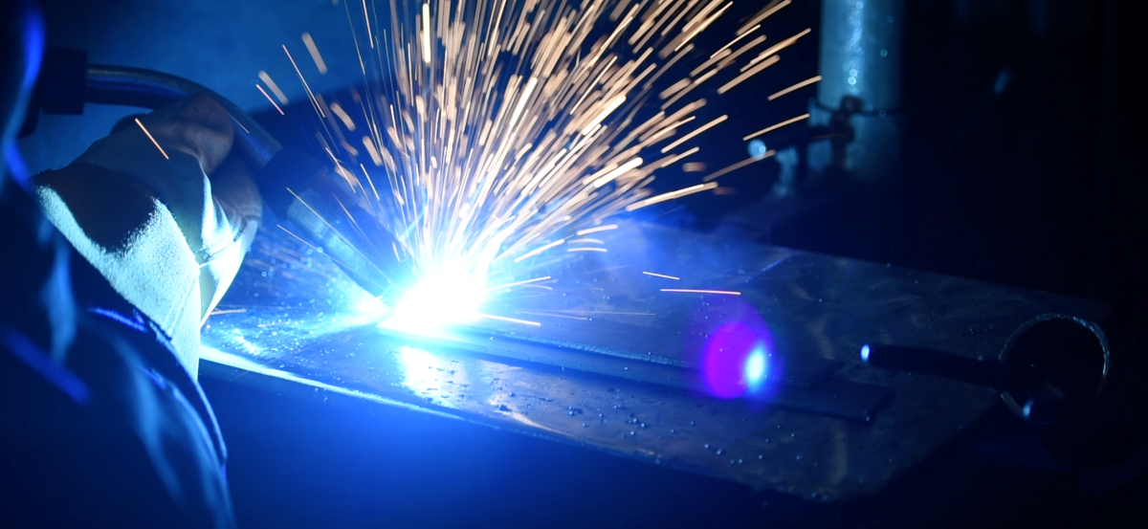
2022 Economic Snapshot
$57,176
Average Annual Wage
$86.9 billion
Total Gross Wages Paid
1.52 Million
Average total employment
Iowa Met Many Positives in 2022:
Surpassed the jobs level seen pre-pandemic
Reached the lowest level of claims in decades
Reduced average duration of benefits to lowest since 1967
Notes:
May Numbers

Slide 9



For the second consecutive year, tax rates on unemployment benefits are the lowest rates allowed by law (Table 8).
Improving the Business Climate
The switch to Table 8 gave Iowa businesses a 25 percent reduction in their UI taxes on average ($72.20 less per employee in 2023).
Governor Reynolds’ recent investments in the UI Trust Fund have resulted in a total of just over $1 billion in employer tax savings.

Slide 10

Reducing Time Between Jobs
Reemployment Case Management Program (RCM) and related changes have already made a significant difference in the state’s relationship to unemployment.
Year-to-Year Reduction in Benefits Paid: $150 million
  Lowest total since 2000
Average duration of benefits declined from 13.5 weeks to 10.7 weeks
  Lowest average since 1967
Initial claims: 45 percent reduction
  Lowest levels since 1973
Continued claims: 53 percent reduction
  Lowest levels since 1974
IWD received National “Full Employment Award”
  In 2022, Iowa had second lowest percentage in the U.S. of claimants who exhausted their UI benefits (13.7%).
2022 by the numbers:

Slide 11

Building a Better System
IWD expanding its focus areas to increase the efficiency of services delivered to Iowa’s workforce.
A new Business Engagement Division serving as a highly engaged partner working alongside employers to solve workforce challenges.
Refocus on Registered Apprenticeship programs and becoming a State Apprenticeship Agency.
Workforce training programs (260) and Internship programs (high-demand and STEM).
New statewide Veterans Portal to make it easier for Veterans and families to connect to new careers.

Slide 12

Serving Iowans Better in 2023
Lifting overall focus on Reemployment.
Working closely with employers to provide individualized assistance through new Business Engagement Division.
Expanding access to services by integrating WIOA Title 2 and Title 4 programs into one workforce system (realignment).
Continuing use of grant opportunities to encourage innovative ideas.

Slide 13
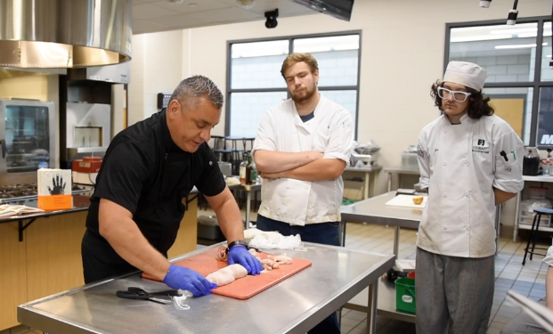


Registered Apprenticeship Programs
Valuable programs that invest in people and empower Iowa employers to grow their own talent base.
Creates rewarding career paths, beginning at the high school level with a proven earn while you learn model.
Long-term solution now available in nearly every sector.
FY 22: Record 10,000+ active apprentices and 163 new programs (890 total programs) - highest number of new programs in the country.
5,402 new apprentices in FY22 and 1,870 apprentices completed certification
By the Numbers (FY 22)
1,988 Participating Employers
9,731 Total Apprentices

Slide 14
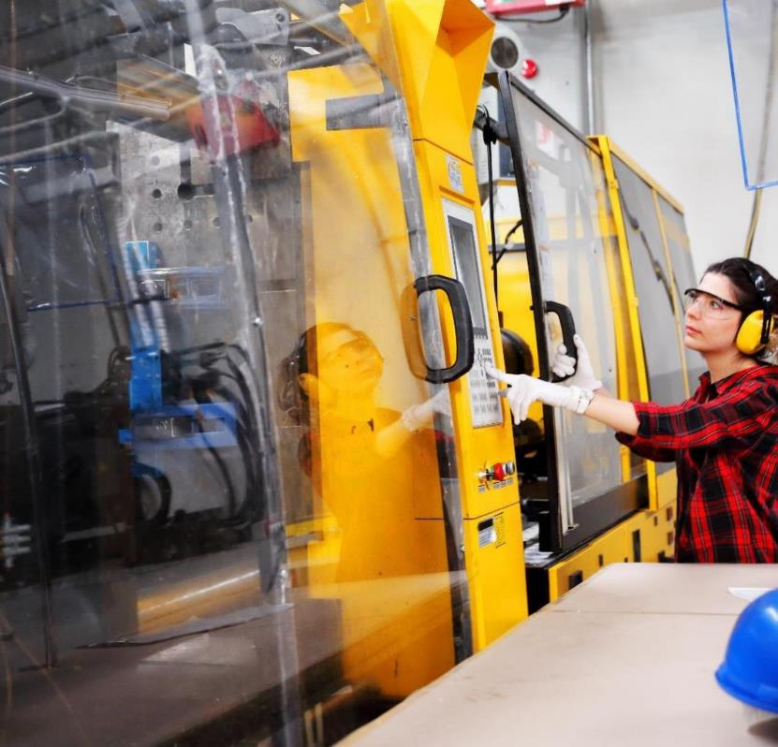
Building The Pipeline
Teacher / Paraeducator RA
First of its kind in the country.
130 school districts participating to add over 1,000 teachers and paraeducators.
Health Careers RA
VR training support combined with real world experience at nursing facilities and hospitals.
Expanded in 2023 to include more occupations.
Supporting 29 projects and 1,931 apprentices in total.

Slide 15
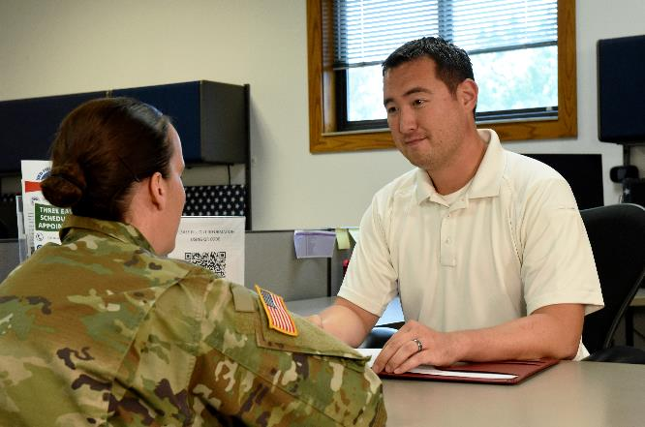


Home Base Iowa
Unique initiative helping make Iowa the premiere destination for Veterans transitioning back to civilian life.
Public-private partnerships to increase commitments to hire Veterans.
Strategies and incentives to help local communities attract Veterans (and their families) to the local workforce.
Since January 1, 2022, over 400 veterans/spouses have found jobs in Iowa through HBI
HBI focuses on empowering communities to be key centers of opportunity by partnering both with employers and local colleges/universities.
By the Numbers
2,400+ designated HBI businesses
120+ designated HBI communities
5 HBI Career Planners

Slide 16

Readying Iowans for Work
Last Dollar Scholarship
Targets high school graduates and adults to help obtain postsecondary credentials/upskill employees.
Focused on high-demand occupations
FY21-FY22:
15,628 participants
Seventeen institutions participating (15 community colleges and two private colleges)
Nearly $34.5 million awarded
Post-Completion (2021 data)
86.6 percent of LDS graduates employed in Iowa, starting with a median wage of $46,461.
Completers earned $12,512 more than those not in LDS-eligible program.

Slide 17

Workforce Training That Drives New Growth
260 Training Programs
Innovative job training programs administered by Iowa Workforce Development that focus on the skills of new and current employees in the occupations needed most.
Iowa Industrial New Jobs Training Program (260E)
  Assists employers creating new positions with new employee training.
  Businesses in program that expand base employment by at least 10 percent can also receive a one-time New Jobs Tax Credit.
Iowa Jobs Training Program (260F)
  Provides job training services to current employees of eligible businesses.
Accelerated Career Education (ACE) Program (260G)
  Helps establish educational programs that train individuals in high-demand occupations most needed by Iowa businesses.

Slide 18
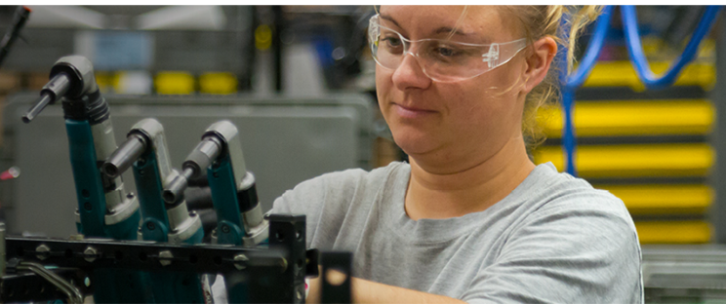
Workforce Training:
By The Numbers (Stats from 2022-2023)
Iowa Industrial New Jobs Training Program (260E)
  Bonds sold in 2022: $55.48 million
  827 current agreements with Iowa employers and 41,610 pledged new jobs
Iowa Jobs Training Program (260F)
  Fiscal Year 2023: $4.75 million awarded
  268 current agreements with 214 employers
Accelerated Career Education (ACE) Program (260G)
  Fiscal Year 2023: $5.4 million awarded
  36 programs with nine participating community colleges and 1,290 sponsored positions
Notes:
260E: Since 1983 (when program was first introduced):
$1,275,222,808 260E Industrial New Jobs Training Program sold
231,700 pledged new jobs.
260F: Since 1985 (when program was first introduced)
$109,355,152 forgivable loans approved
Over 245,000 individuals trained

Slide 19
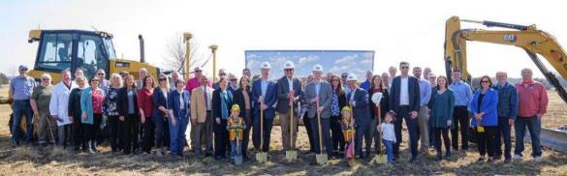
Removing Barriers
Grants
Entry-Level Driving Training Program (CDL) and CDL infrastructure grants
Summer Youth Internships
Language Learners Job Training Program
Work-based Learning Grant
Home Base Iowa
Backed by over 2,000 businesses and 120 communities
New one-on-one assistance helped 300 Veterans or spouses find employment in 2022
Child Care Grants (community projects and business incentives)
2021-2022: 190 projects awarded $75 million to help create more than 10,700 new child care slots
Iowa has prioritized unique grant and employment programs that are focused on removing the most frequent barriers to the workforce.

Slide 20
Building a Better System
IWD expanding its focus areas to increase the efficiency of services delivered to Iowa’s workforce.
A new Business Engagement Division serving as a highly engaged partner working alongside employers to solve workforce challenges.
Refocus on Registered Apprenticeship programs and becoming a State Apprenticeship Agency.
Workforce training programs (260) and Internship programs (high-demand and STEM).
New statewide Veterans Portal to make it easier for Veterans and families to connect to new careers.

Slide 21

And Realigning Programs
IWD assumed responsibility of the following on July 1 under Governor Reynolds’ realignment legislation:
  Iowa Vocational Rehabilitation Services
  Adult Education and Literacy Programs
  HiSet High School Equivalency Test
Brings together all four groups of workforce programs under the Workforce Innovation and Opportunity Act (WIOA).
Incredible opportunity to increase efficiency and coordinate delivery of service to Iowans.

Slide 22

In Summary
“In Iowa, America still works; In a world increasingly marked by uncertainty, Iowa’s strength and stability stand out as a beacon of hope.”
- Governor Reynolds

Slide 23

Thank you
Kathy Anderson, Division Administrator, Business Engagement
Kathy.Anderson@IWD.Iowa.gov
1000 E Grand Avenue • Des Moines, IA 50319 • https://workforce.iowa.gov/

Slide 24




Slide 26

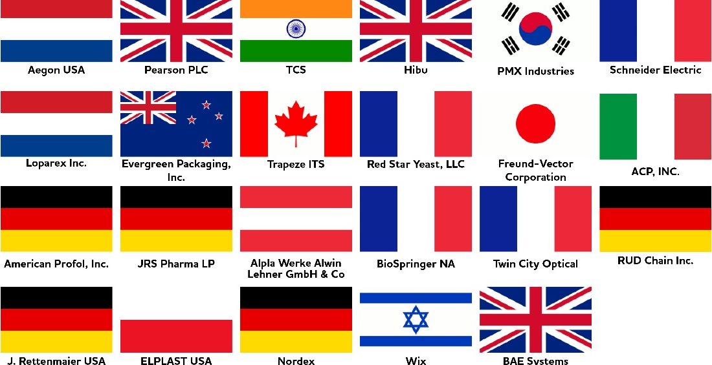
FAST FACTS
MSA POPULATION: 276,520
LEADING INDUSTRIES:
Advanced Manufacturing
Transportation/Logistics
Engineering/Automation
Biotech/Medical Technology
Aerospace
Food & Bio-Processing
Education & Tech Services
Area International Companies

Slide 27



Slide 28




Workforce Development Highlights
Skill Up CR

Slide 29

Downtown Vision Plan Update
LIVE
Capitalize on ne housing development
in and around Downtown; attract
additional housing
WORK
Consider office uncertainty; explore
flex-space/coworking/housing conversions; highlight & expand small-scale and ag manufacturing niches
SHOP & DINE
Diversify ground floor offerings; add local independent and unique businesses and restaurants; add niche- and resident-serving retail; explore creative uses
VISIT & STAY
Attract additional hotel rooms; build on live music and outdoor recreation niches

Slide 30
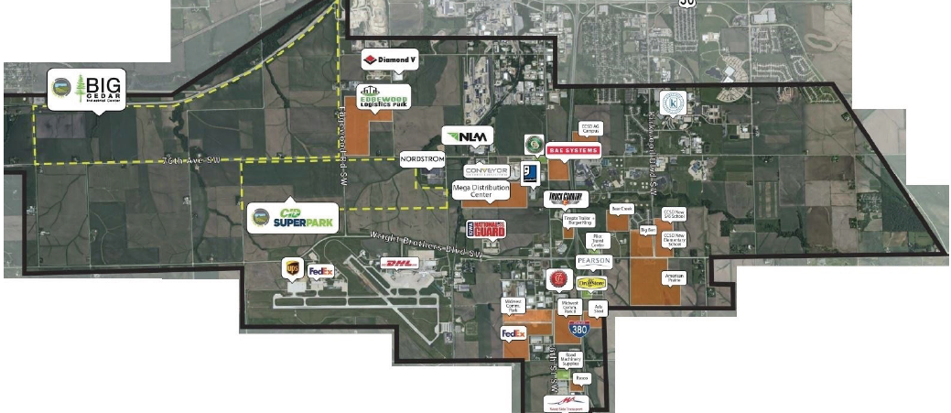
Southwest Growth Area

Slide 31
Cedar Rapids Population & Growth Stats
Record Construction
Permit Valuations
FY 2021, 2022
(FY2023 second-highest, behind 2022)
7% Predicted
Employment Growth
by 2030
State of Iowa: 3%
$30 Billion
Annual Economic Output
by mid-2033
Gross Metro Product Expansion: 3.25%
1% Annual
Population Growth
Nearly 2x Iowa Average
From 2016–2020, more people moved to the area
from out of state than moved away from Cedar Rapids.

Slide 32
Housing Need
Demand for thousands of housing units:
  1,414 market-rate rentals,
  1,085 shallow-subsidy rentals,
  735 deep-subsidy rentals,
  1,586 for-sale, single-family units, and
  526 for-sale, multifamily units

Slide 33

Collaborative Growth Initiative

Slide 35
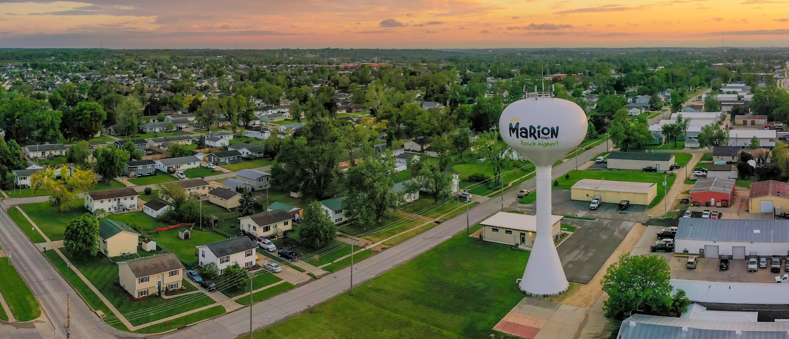

Collaborative Growth Initiative
Nick AbouAssaly, Mayor

Slide 36
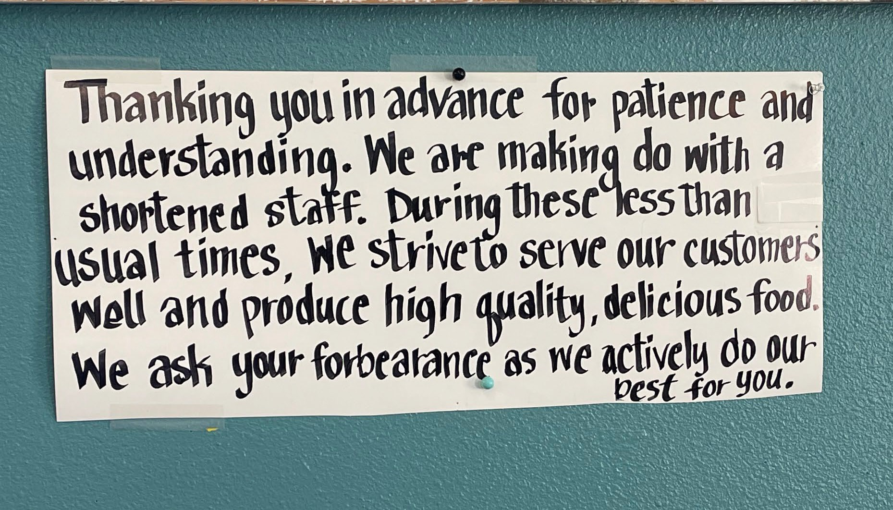

Slide 37




City of Marion Population Growth
50,000
45,000
40,000
35,000
30,000
25,000
20,000
15,000
10,000
5,000
-
Estimated Population
Year
Past Growth
Projected Growth

Slide 38
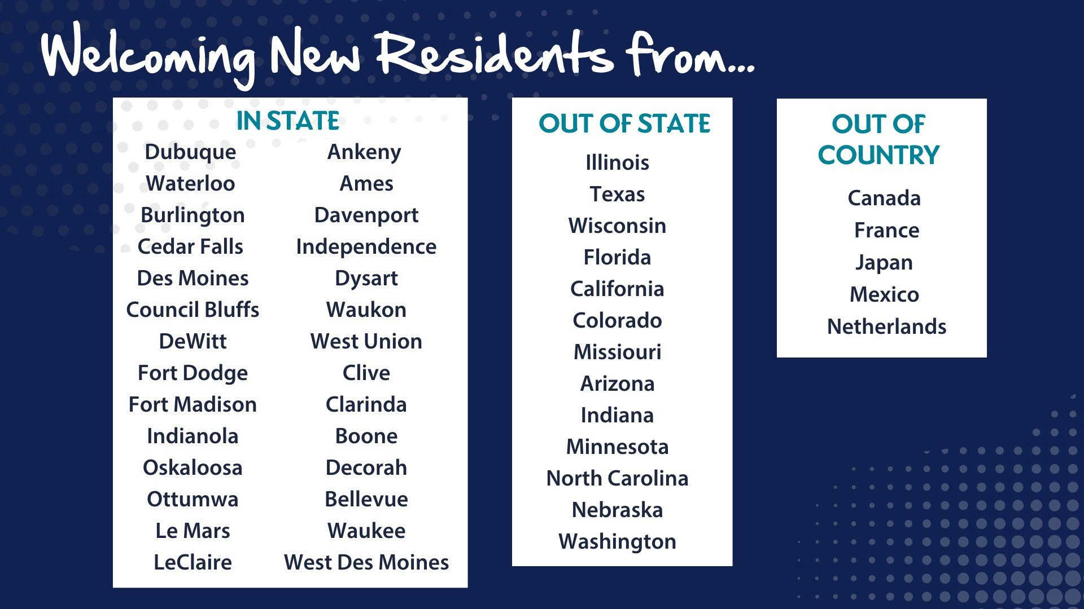

Slide 39

Investing in Quality of Life Amenities

Slide 40
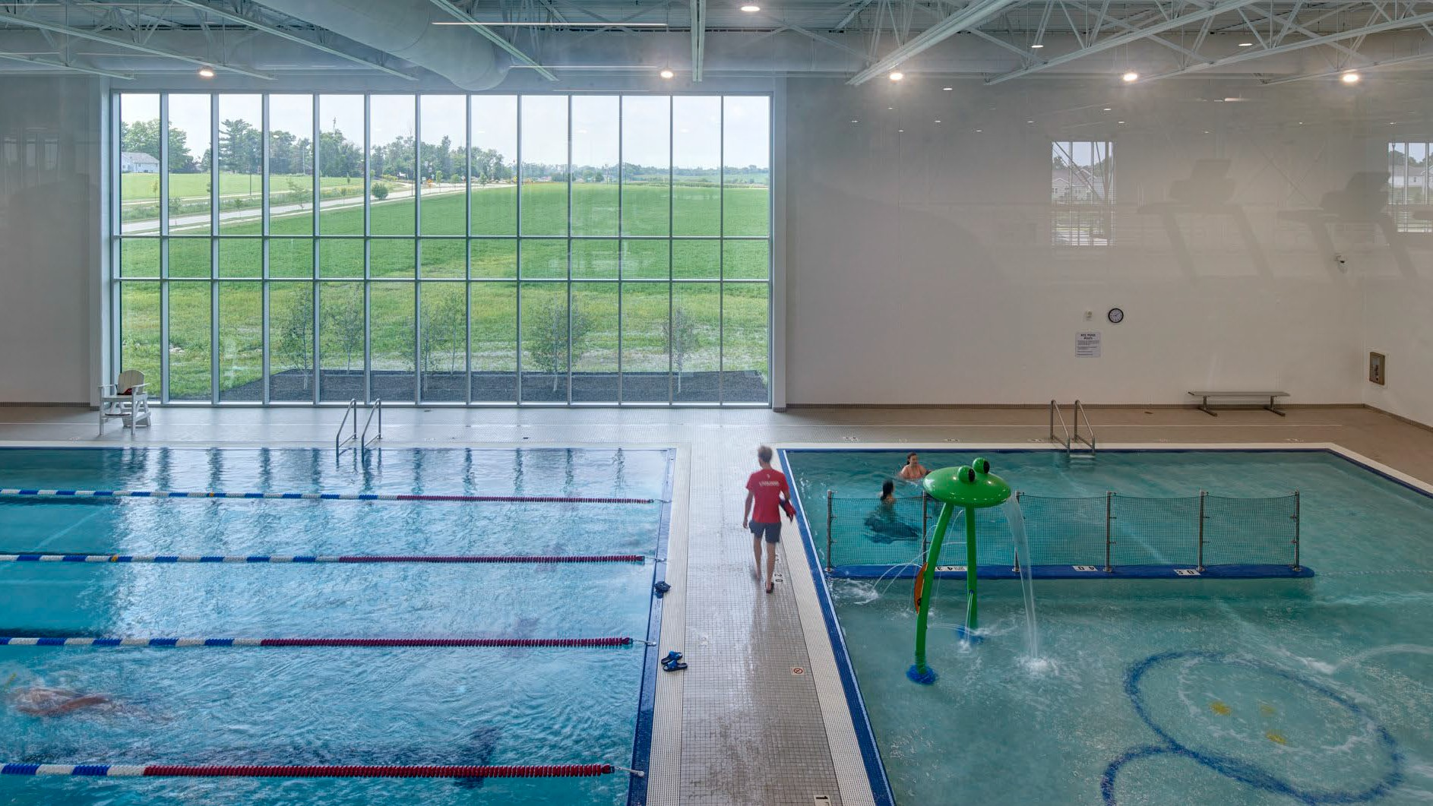

Slide 41


Slide 42


Slide 43


Slide 44


Slide 45


Slide 46



